Slide 1
Parametric Search (Megiddo ’83)
Android Library for CS1
Ivaylo Ilinkin
Gettysburg College

Slide 2
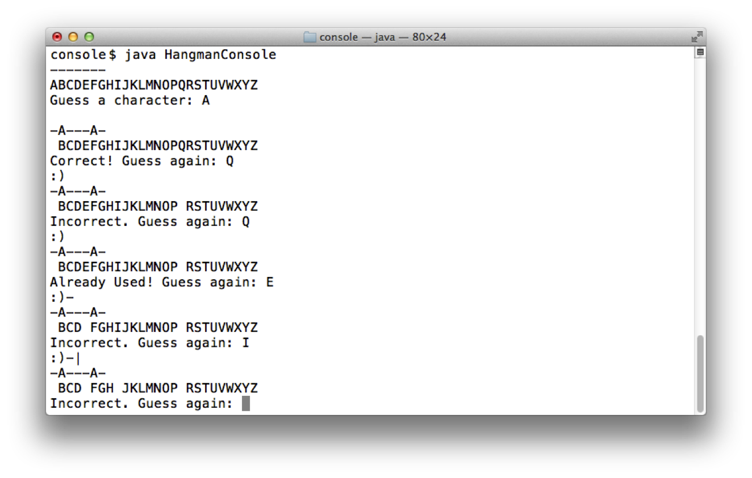
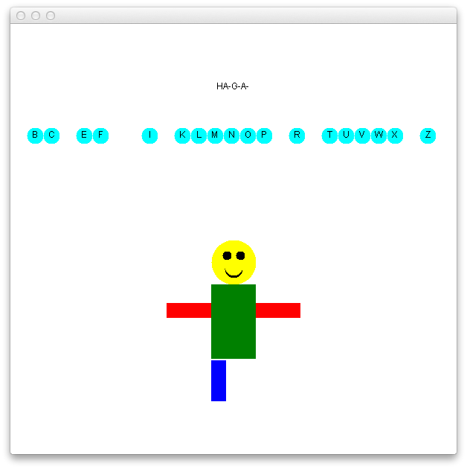
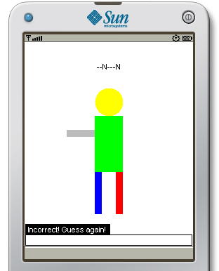
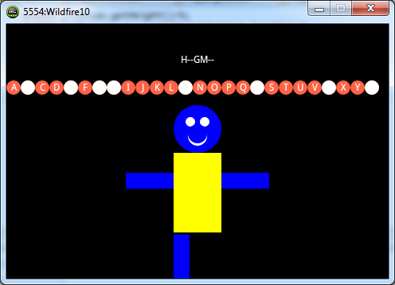
Hangman Evolution
C++ Days
Java Days
J2ME Days
Android Days

Slide 3
Library Goals
Require no knowledge of Android
Require no knowledge of object-oriented concepts
support objects-late
Have minimal impact on planned course schedule

Slide 4
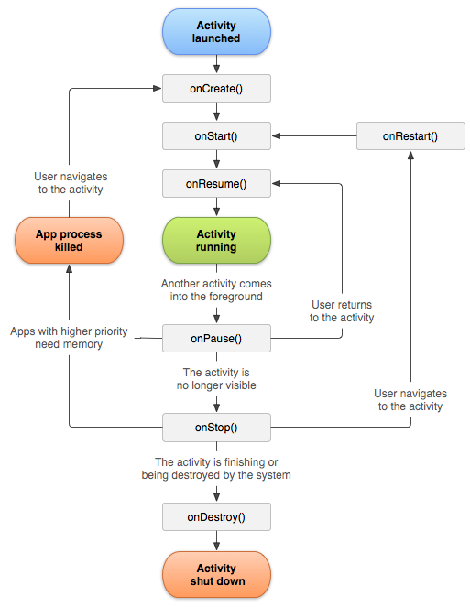
Challenges
Complex Activity life cycle
Event-driven model
Blocking interaction not available

Slide 5
App Structure
extends AndroidApp
class Smiley
{
public static void main(String[] args)
{
}
}
public void run()

Slide 6
Drawing Shapes (procedural)
canvas.drawCircle(x, y, r, color)
canvas.drawRectangle(x, y, w, h, color)
canvas.drawImage(x, y, filename)
canvas.drawText(x, y, text, color, size)

Slide 7
Drawing Shapes (objects)
Circle c = new Circle(new Point(10, 20), 30);
c.setColor(“tomato”);
c.draw();
Text t = new Text(new Point(10, 20), “CS1”);
t.setColor(“cyan”);
t.draw();

Slide 8
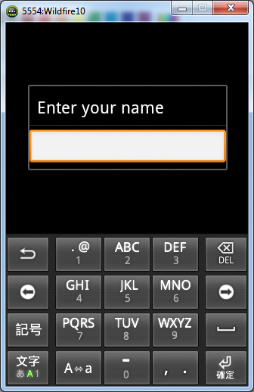
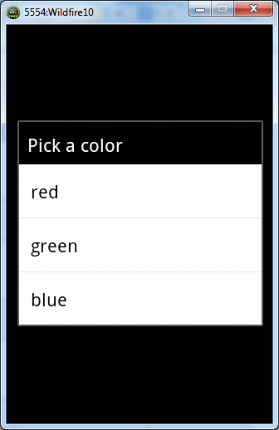
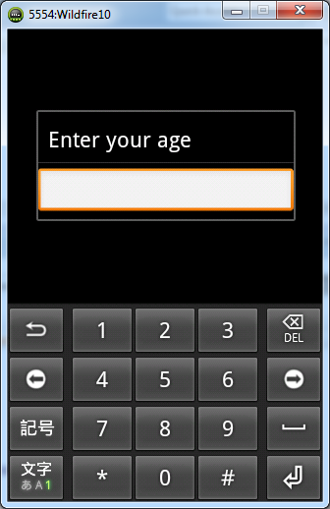
Blocking Keypad Input
canvas.readString(…)
canvas.readSelection(…)
canvas.readInt(…)
Blocking and behaves like the Scanner

Slide 9

Blocking Touch Input
Touch touch = canvas.waitForTouch();
int x = touch.getX();
int y = touch.getY();
canvas.drawCircle(x, y, 30, “cyan”);

Slide 10
Blocking Swipe Input
Fling fling = canvas.waitForFling();
int dx = fling.getDx();
int dy = fling.getDy();
canvas.drawCircle(x+dx, y+dy, 30, “cyan”);

Slide 11
Touch/Swipe API
touch.getX() touch.getTaps()
touch.getShape()
fling.getStartX() fling.getEndX()
fling.getDx() fling.getVy()
fling.getShape()

Slide 12
Media API
canvas.drawImage( cx, cy, filename );
canvas.playAudio( filename );
canvas.setBackgroundMusic( filename );
canvas.stopBackgroundMusic( );

Slide 13
Parametric Search (Megiddo ’83)
Software Setup

Slide 14
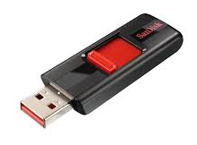

Student Setup
Fits on a USB (~4GB) for Mac, Windows, Linux
Includes Android SDK, Java JDK, DrJava IDE
starts DrJava
and emulator
drjava
hw/
class/
software/
haxm/haxm.(exe|dmg)
hardware acclelerator
one-time install

Slide 15

Today’s Setup (Mac Users)
Shutdown, Insert USB
Hold Right Option Key, Restart

Slide 16
Today’s Setup (Mac Users – Alternate)
Boot Normally, Insert USB, Open Terminal
/dev/disk2
. . .
1: EFI CCSC 7.9 GB disk2s1
....
diskutil list
diskutil mount disk2s1
drjava
hw/
class/
software/haxm/haxm.dmg
cs1android
install

Slide 17
Today’s Setup (Windows Users)
Shutdown, Insert USB
Restart, Quickly hit F12 or F2 or Del or Esc (boot sequence)
Look for USB UEFI and select
Surface Users – see handout

Slide 18
Today’s Setup (Mac Users – Alternate)
Boot Normally, Insert USB, Go to D:\cs1android
drjava
hw/
class/
software/haxm/haxm.exe
cs1android
install

Slide 19
Parametric Search (Megiddo ’83)
Workshop Examples

Slide 20
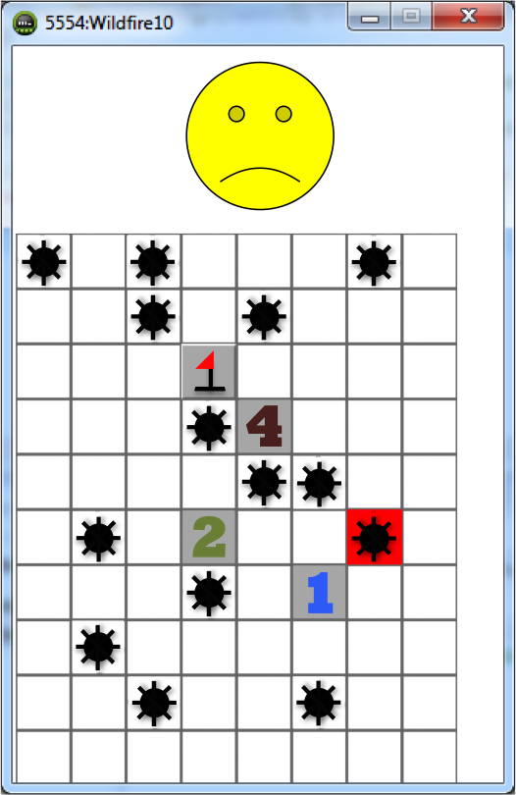
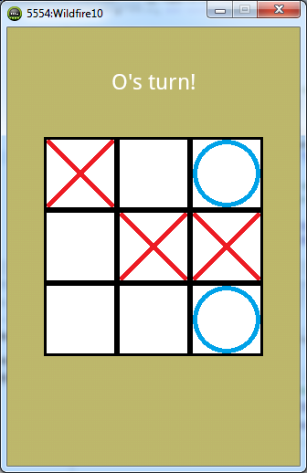
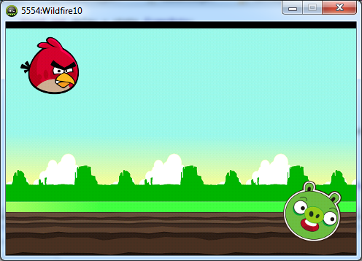
Workshop Examples

Slide 21
Parametric Search (Megiddo ’83)
Landscape vs Portrait

Slide 22
Portrait vs Landscape
Edit AndroidManifest.xml
AndroidManifest.xml
bin/
lib/
Res/
src/
MyApp
<!-- change "portrait" to "landscape" if desired -->
<activity
android:screenOrientation="portrait"
android:name=".MyApp" >
. . .
</activity>

Slide 23
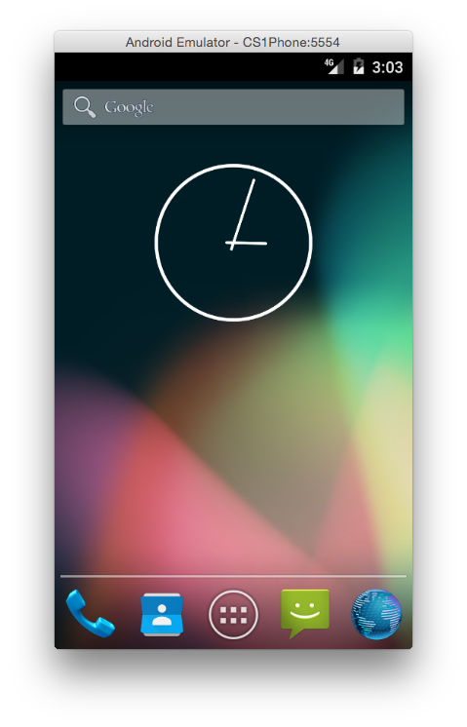

Portrait vs Landscape

Slide 24
Parametric Search (Megiddo ’83)
Android or Java Mode

Slide 25
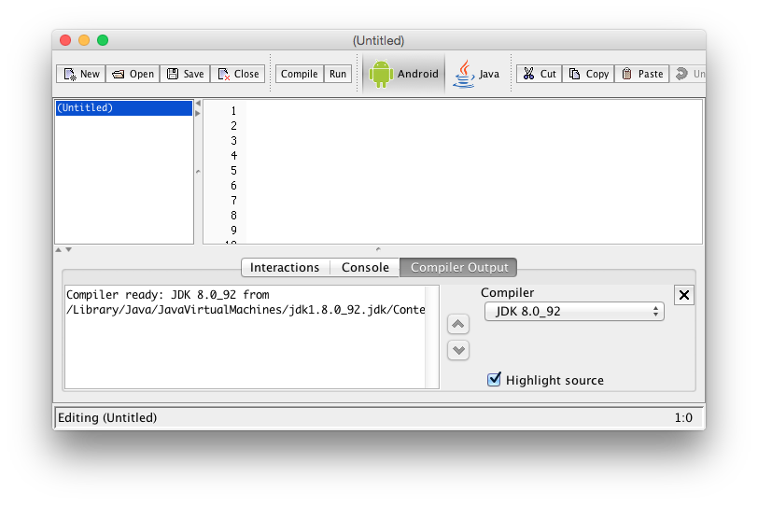
Android or Java Mode

Slide 26
Parametric Search (Megiddo ’83)
Touch Input Details

Slide 27
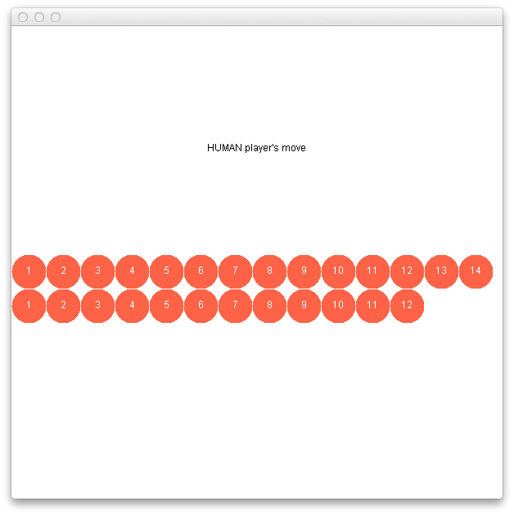
Selecting Shapes
Touch touch = canvas.waitForTouch();
int index = touch.getX() / diameter; (objects-late)
Shape shape = touch.getShape(); (objects-early)

Slide 28
Selecting Shapes
Touch touch = canvas.waitForTouch();
int row = (touch.getY() – ULY) / diameter;
int col = (touch.getX() – ULX) / diameter;

Slide 29
Parametric Search (Megiddo ’83)
Example Apps

Slide 30
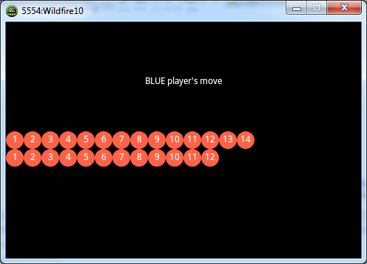
Example Apps

Slide 31
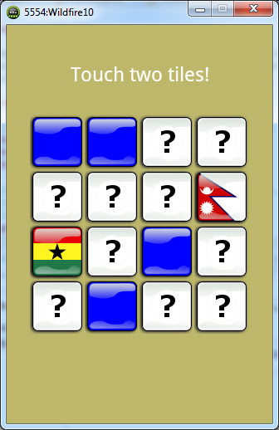
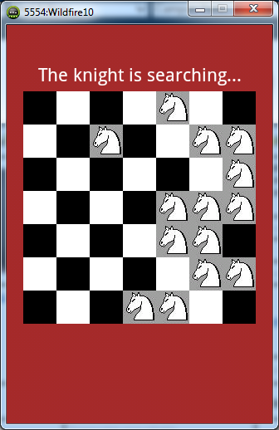
Example Apps

Slide 32
Parametric Search (Megiddo ’83)
jGRASP, BlueJ Integration

Slide 33

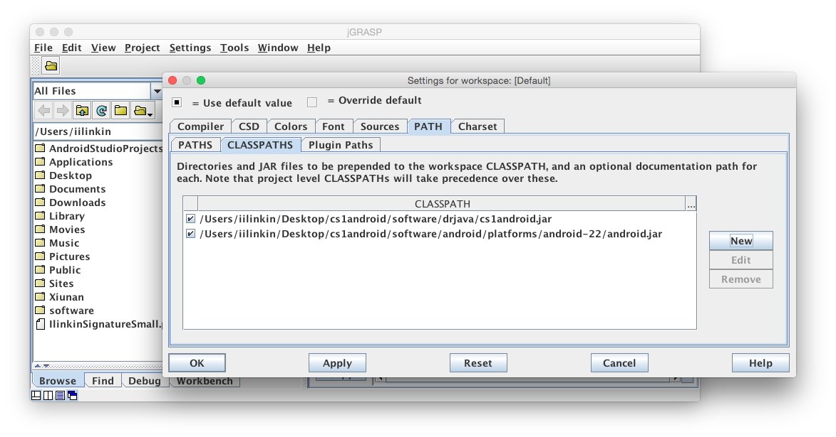
jGRASP, BlueJ Integration

Slide 34
Summary
Designed to integrate seamlessly in a CS1 course
Supports objects-late and objects-early approach
Fits well with turn-based board games
http://www.cs.gettysburg.edu/~ilinkin/cs1android

