Slide 1
Programming Environments
DrJava is not Java! It is an integrated environment for
developing Java programs
DrJava integrates the Edit => Compile => Run cycle
Other: jGrasp, BlueJ, Eclipse

Slide 2
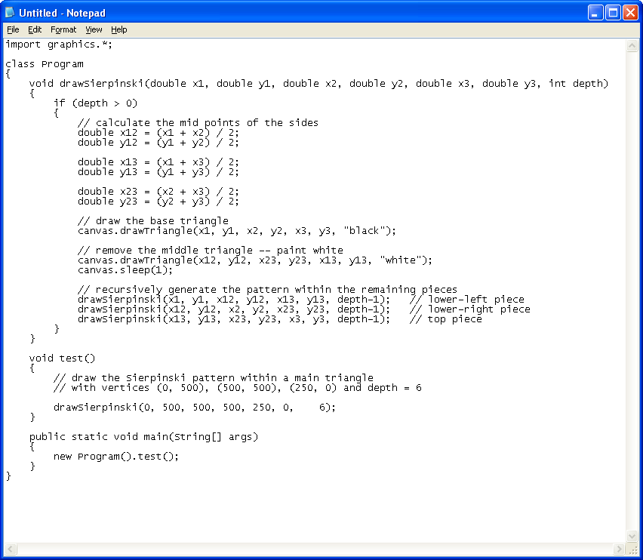
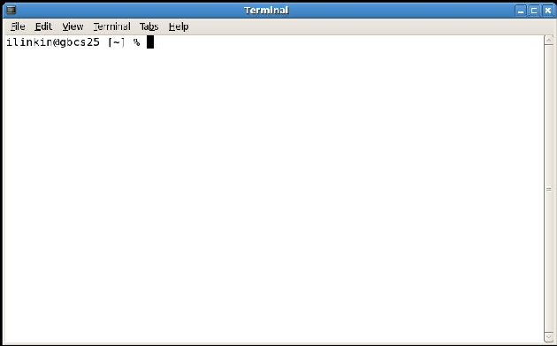
Java Program Development Cycle
Edit => Compile => Run
Edit: create Program.java
Compile: create Program.class
javac Program.java
Run
java Program
Program.java – human readable
Program.class – machine readable

Slide 3
Java Primitive Types
boolean – for true/false values
char – for single character values
short, int, long – for integer values
short [ -32,768 … 32,767 ]
int [ -2,147,483,648 … 2,147,483,647 ]
long [ -9,223,372,036,854,775,808 … 9,223,372,036,854,775,807 ]
float, double – for real values
float has smaller range than double

Slide 4
In how many ways can you say X = X + 1 ?
X = X + 1;
X += 1;
X++;
++X;
X = X – 1; X = X * 5; X = X / 5;
X -= 1; X *= 5; X /= 5;
X--;
--X;

Slide 5
X++ vs ++X
X = 5;
X = 5;
2: update the value of X
1: update the value of X
Y = X++;
Y = ++X;
1: “use” the value of X
2: “use” the value of X
Y is now 5
X is now 6
X is now 6
Y is also 6

Slide 6
X++ vs ++X
X = 5;
X = 5;
2: update X
1: update X
System.out.println(X++);
System.out.println(++X);
1: “use” the value of X
2: “use” the value of X
displays 5
X is now 6
X is now 6
displays 6

Slide 7
Integer Division
Dividing integers always yields integer value
7 / 3 = 2
int x = 7;
int y = 3;
int z1 = x / y; // z1 is now 2
double z2 = x / y; // z2 is now 2
Remainder operator %
7 / 3 = 2 and 1 left over, so 7 % 3 = 1
9 / 5 = 1 and 4 left over, so 9 % 5 = 4
21 / 5 = 4 and 1 left over, so 21 % 5 = 1

Slide 8
Remainder % Operator Use
if ( n % 2 == 0 )
{
System.out.println( “n is even “ );
}
if ( n % 5 == 0 )
{
System.out.println( “n is divisible by 5 “ );
}
player = ( player + 1 ) % n;

Slide 9
do-while loop
while ( something-is-true )
{
action 1;
action 2;
...
action n
}
do-while guaranteed to
execute at least once
do
{
action 1;
action 2;
...
action n
}
while ( something-is-true )

Slide 10
Return in void Methods
void drawCirclesRow( double x, double y, double r, int n)
{
if (n <= 0)
{
return; // OK without value
}
... rest of the code here ...
}

Slide 11
Enhanced FOR Loop
void printArray( double[] numbers )
{
for ( int i = 0 ; i < numbers.length ; i++ )
{
double curValue = numbers[ i ];
System.out.print( curValue + “ “);
}
System.out.println();
}
void printArray( double[] numbers )
{
for ( double curValue : numbers )
{
System.out.print( curValue + “ “);
}
System.out.println();
}

Slide 12
Enhanced FOR Loop
void printArray( double[] numbers )
{
for ( int i = 0 ; i < numbers.length ; i++ )
{
double curValue = numbers[ i ];
System.out.print( curValue + “ “);
}
System.out.println();
}
void printArray( double[] numbers )
{
for ( double curValue : numbers )
{
System.out.print( curValue + “ “);
}
System.out.println();
}

Slide 13
Enhanced FOR Loop
double addNumbers( double[] numbers )
{
double result = 0;
for ( int i = 0 ; i < numbers.length ; i++ )
{
double curValue = numbers[ i ];
result = result + curValue;
}
return result;
}
double addNumbers( double[] numbers )
{
double result = 0;
for ( double curValue : numbers )
{
result = result + curValue;
}
return result;
}

Slide 14
Enhanced FOR Loop
double addNumbers( double[] numbers )
{
double result = 0;
for ( int i = 0 ; i < numbers.length ; i++ )
{
double curValue = numbers[ i ];
result = result + curValue;
}
return result;
}
double addNumbers( double[] numbers )
{
double result = 0;
for ( double curValue : numbers )
{
result = result + curValue;
}
return result;
}

Slide 15
Enhanced FOR Loop
void driftBalloons( )
{
for ( int i = 0 ; i < balloons.size() ; i++ )
{
Balloon b = balloons.get( i );
b.drift( ... );
}
}
void driftBalloons( )
{
for ( Balloon b : balloons )
{
b.drift( ... );
}
}

Slide 16
Enhanced FOR Loop
void driftBalloons( )
{
for ( int i = 0 ; i < balloons.length ; i++ )
{
Balloon b = balloons.get( i );
b.drift( ... );
}
}
void driftBalloons( )
{
for ( Balloon b : balloons )
{
b.drift( ... );
}
}

