Slide 1
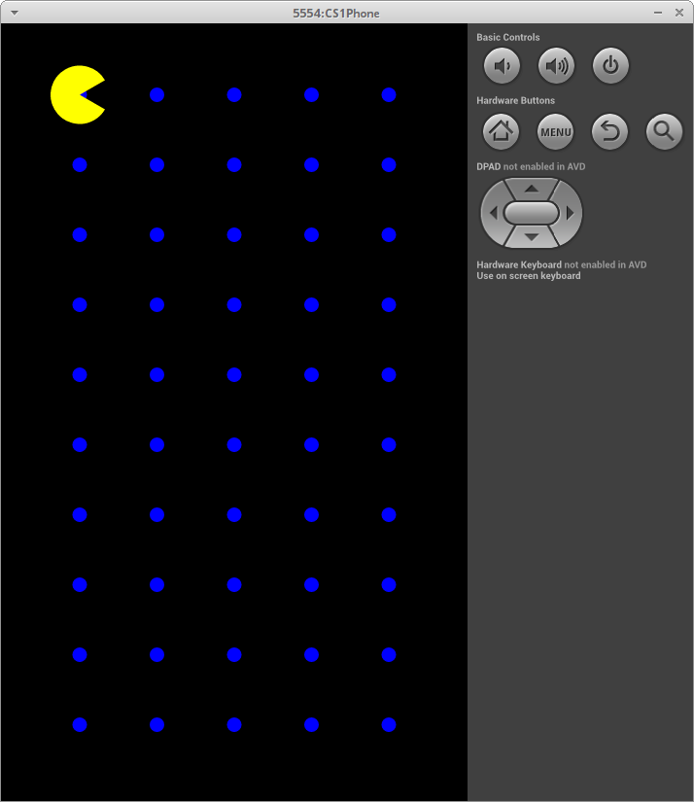
public class ParkApp
{
public void run()
{
Balloon b1 = new Balloon( "red", 30 );
Balloon b2 = new Balloon( "green", 50, 100, 500 );
Balloon b3 = new Balloon( "blue", 40, 200, 450 );
b1.draw( );
b2.draw( );
b3.draw( );
b1.drift( 4, 2 );
b2.drift( 3, 3 );
b3.drift( 1, 5 );
b1.draw( );
b2.draw( );
b3.draw( );
}
}

Slide 2
public class ParkApp
{
public void run()
{
Balloon b1 = new Balloon( "red", 30 );
Balloon b2 = new Balloon( "green", 50, 100, 500 );
Balloon b3 = new Balloon( "blue", 40, 200, 450 );
b1.draw( );
b2.draw( );
b3.draw( );
b1.drift( 4, 2 );
b2.drift( 3, 3 );
b3.drift( 1, 5 );
b1.draw( );
b2.draw( );
b3.draw( );
}
}
b1
color: “red”
size: 30
curX: 0
curY: 0
public Balloon( String c, double s )
{
color = c;
size = s;
curX = 0;
curY = 0;
}

Slide 3
public class ParkApp
{
public void run()
{
Balloon b1 = new Balloon( "red", 30 );
Balloon b2 = new Balloon( "green", 50, 100, 500 );
Balloon b3 = new Balloon( "blue", 40, 200, 450 );
b1.draw( );
b2.draw( );
b3.draw( );
b1.drift( 4, 2 );
b2.drift( 3, 3 );
b3.drift( 1, 5 );
b1.draw( );
b2.draw( );
b3.draw( );
}
}
b1
b2
color: “red”
size: 30
curX: 0
curY: 0
color: “green”
size: 50
curX: 100
curY: 500
public Balloon( String c, double s, double x, double y )
{
color = c;
size = s;
curX = x;
curY = y;
}

Slide 4
public class ParkApp
{
public void run()
{
Balloon b1 = new Balloon( "red", 30 );
Balloon b2 = new Balloon( "green", 50, 100, 500 );
Balloon b3 = new Balloon( "blue", 40, 200, 450 );
b1.draw( );
b2.draw( );
b3.draw( );
b1.drift( 4, 2 );
b2.drift( 3, 3 );
b3.drift( 1, 5 );
b1.draw( );
b2.draw( );
b3.draw( );
}
}
b1
b2
b3
color: “red”
size: 30
curX: 0
curY: 0
color: “green”
size: 50
curX: 100
curY: 500
color: “blue”
size: 40
curX: 200
curY: 450
public Balloon( String c, double s, double x, double y )
{
color = c;
size = s;
curX = x;
curY = y;
}

Slide 5
public class ParkApp
{
public void run()
{
Balloon b1 = new Balloon( "red", 30 );
Balloon b2 = new Balloon( "green", 50, 100, 500 );
Balloon b3 = new Balloon( "blue", 40, 200, 450 );
b1.draw( );
b2.draw( );
b3.draw( );
b1.drift( 4, 2 );
b2.drift( 3, 3 );
b3.drift( 1, 5 );
b1.draw( );
b2.draw( );
b3.draw( );
}
}
b1
b2
b3
color: “red”
size: 30
curX: 0
curY: 0
color: “green”
size: 50
curX: 100
curY: 500
color: “blue”
size: 40
curX: 200
curY: 450
public void draw( )
{
canvas.drawCircle( curX, curY, size, color );
}

Slide 6
public class ParkApp
{
public void run()
{
Balloon b1 = new Balloon( "red", 30 );
Balloon b2 = new Balloon( "green", 50, 100, 500 );
Balloon b3 = new Balloon( "blue", 40, 200, 450 );
b1.draw( );
b2.draw( );
b3.draw( );
b1.drift( 4, 2 );
b2.drift( 3, 3 );
b3.drift( 1, 5 );
b1.draw( );
b2.draw( );
b3.draw( );
}
}
b1
b2
b3
color: “red”
size: 30
curX: 0
curY: 0
color: “green”
size: 50
curX: 100
curY: 500
color: “blue”
size: 40
curX: 200
curY: 450
public void draw( )
{
canvas.drawCircle( curX, curY, size, color );
}

Slide 7
public class ParkApp
{
public void run()
{
Balloon b1 = new Balloon( "red", 30 );
Balloon b2 = new Balloon( "green", 50, 100, 500 );
Balloon b3 = new Balloon( "blue", 40, 200, 450 );
b1.draw( );
b2.draw( );
b3.draw( );
b1.drift( 4, 2 );
b2.drift( 3, 3 );
b3.drift( 1, 5 );
b1.draw( );
b2.draw( );
b3.draw( );
}
}
b1
b2
b3
color: “red”
size: 30
curX: 0
curY: 0
color: “green”
size: 50
curX: 100
curY: 500
color: “blue”
size: 40
curX: 200
curY: 450
public void draw( )
{
canvas.drawCircle( curX, curY, size, color );
}

Slide 8
public class ParkApp
{
public void run()
{
Balloon b1 = new Balloon( "red", 30 );
Balloon b2 = new Balloon( "green", 50, 100, 500 );
Balloon b3 = new Balloon( "blue", 40, 200, 450 );
b1.draw( );
b2.draw( );
b3.draw( );
b1.drift( 4, 2 );
b2.drift( 3, 3 );
b3.drift( 1, 5 );
b1.draw( );
b2.draw( );
b3.draw( );
}
}
b1
b2
b3
color: “red”
size: 30
curX: 0
curY: 0
color: “green”
size: 50
curX: 100
curY: 500
color: “blue”
size: 40
curX: 200
curY: 450
public void draw( )
{
canvas.drawCircle( curX, curY, size, color );
}

Slide 9
public class ParkApp
{
public void run()
{
Balloon b1 = new Balloon( "red", 30 );
Balloon b2 = new Balloon( "green", 50, 100, 500 );
Balloon b3 = new Balloon( "blue", 40, 200, 450 );
b1.draw( );
b2.draw( );
b3.draw( );
b1.drift( 4, 2 );
b2.drift( 3, 3 );
b3.drift( 1, 5 );
b1.draw( );
b2.draw( );
b3.draw( );
}
}
b1
b2
b3
color: “red”
size: 30
curX: 0
curY: 0
color: “green”
size: 50
curX: 100
curY: 500
color: “blue”
size: 40
curX: 200
curY: 450
public void draw( )
{
canvas.drawCircle( curX, curY, size, color );
}

Slide 10
public class ParkApp
{
public void run()
{
Balloon b1 = new Balloon( "red", 30 );
Balloon b2 = new Balloon( "green", 50, 100, 500 );
Balloon b3 = new Balloon( "blue", 40, 200, 450 );
b1.draw( );
b2.draw( );
b3.draw( );
b1.drift( 4, 2 );
b2.drift( 3, 3 );
b3.drift( 1, 5 );
b1.draw( );
b2.draw( );
b3.draw( );
}
}
b1
b2
b3
color: “red”
size: 30
curX: 0
curY: 0
color: “green”
size: 50
curX: 100
curY: 500
color: “blue”
size: 40
curX: 200
curY: 450
public void draw( )
{
canvas.drawCircle( curX, curY, size, color );
}

Slide 11
public class ParkApp
{
public void run()
{
Balloon b1 = new Balloon( "red", 30 );
Balloon b2 = new Balloon( "green", 50, 100, 500 );
Balloon b3 = new Balloon( "blue", 40, 200, 450 );
b1.draw( );
b2.draw( );
b3.draw( );
b1.drift( 4, 2 );
b2.drift( 3, 3 );
b3.drift( 1, 5 );
b1.draw( );
b2.draw( );
b3.draw( );
}
}
b1
b2
b3
color: “red”
size: 30
curX: 0
curY: 0
color: “green”
size: 50
curX: 100
curY: 500
color: “blue”
size: 40
curX: 200
curY: 450
public void drift( double dx, double dy )
{
curX = curX + dx;
curY = curY + dy;
}

Slide 12
public class ParkApp
{
public void run()
{
Balloon b1 = new Balloon( "red", 30 );
Balloon b2 = new Balloon( "green", 50, 100, 500 );
Balloon b3 = new Balloon( "blue", 40, 200, 450 );
b1.draw( );
b2.draw( );
b3.draw( );
b1.drift( 4, 2 );
b2.drift( 3, 3 );
b3.drift( 1, 5 );
b1.draw( );
b2.draw( );
b3.draw( );
}
}
b1
b2
b3
color: “red”
size: 30
curX: 4
curY: 2
color: “green”
size: 50
curX: 100
curY: 500
color: “blue”
size: 40
curX: 200
curY: 450
public void drift( double dx, double dy )
{
curX = curX + dx;
curY = curY + dy;
}

Slide 13
public class ParkApp
{
public void run()
{
Balloon b1 = new Balloon( "red", 30 );
Balloon b2 = new Balloon( "green", 50, 100, 500 );
Balloon b3 = new Balloon( "blue", 40, 200, 450 );
b1.draw( );
b2.draw( );
b3.draw( );
b1.drift( 4, 2 );
b2.drift( 3, 3 );
b3.drift( 1, 5 );
b1.draw( );
b2.draw( );
b3.draw( );
}
}
b1
b2
b3
color: “red”
size: 30
curX: 4
curY: 2
color: “green”
size: 50
curX: 100
curY: 500
color: “blue”
size: 40
curX: 200
curY: 450
public void drift( double dx, double dy )
{
curX = curX + dx;
curY = curY + dy;
}

Slide 14
public class ParkApp
{
public void run()
{
Balloon b1 = new Balloon( "red", 30 );
Balloon b2 = new Balloon( "green", 50, 100, 500 );
Balloon b3 = new Balloon( "blue", 40, 200, 450 );
b1.draw( );
b2.draw( );
b3.draw( );
b1.drift( 4, 2 );
b2.drift( 3, 3 );
b3.drift( 1, 5 );
b1.draw( );
b2.draw( );
b3.draw( );
}
}
b1
b2
b3
color: “red”
size: 30
curX: 4
curY: 2
color: “green”
size: 50
curX: 103
curY: 503
color: “blue”
size: 40
curX: 200
curY: 450
public void drift( double dx, double dy )
{
curX = curX + dx;
curY = curY + dy;
}

Slide 15
public class ParkApp
{
public void run()
{
Balloon b1 = new Balloon( "red", 30 );
Balloon b2 = new Balloon( "green", 50, 100, 500 );
Balloon b3 = new Balloon( "blue", 40, 200, 450 );
b1.draw( );
b2.draw( );
b3.draw( );
b1.drift( 4, 2 );
b2.drift( 3, 3 );
b3.drift( 1, 5 );
b1.draw( );
b2.draw( );
b3.draw( );
}
}
b1
b2
b3
color: “red”
size: 30
curX: 4
curY: 2
color: “green”
size: 50
curX: 103
curY: 503
color: “blue”
size: 40
curX: 200
curY: 450
public void drift( double dx, double dy )
{
curX = curX + dx;
curY = curY + dy;
}

Slide 16
public class ParkApp
{
public void run()
{
Balloon b1 = new Balloon( "red", 30 );
Balloon b2 = new Balloon( "green", 50, 100, 500 );
Balloon b3 = new Balloon( "blue", 40, 200, 450 );
b1.draw( );
b2.draw( );
b3.draw( );
b1.drift( 4, 2 );
b2.drift( 3, 3 );
b3.drift( 1, 5 );
b1.draw( );
b2.draw( );
b3.draw( );
}
}
b1
b2
b3
color: “red”
size: 30
curX: 4
curY: 2
color: “green”
size: 50
curX: 103
curY: 503
color: “blue”
size: 40
curX: 201
curY: 455
public void drift( double dx, double dy )
{
curX = curX + dx;
curY = curY + dy;
}

Slide 17
public class ParkApp
{
public void run()
{
Balloon b1 = new Balloon( "red", 30 );
Balloon b2 = new Balloon( "green", 50, 100, 500 );
Balloon b3 = new Balloon( "blue", 40, 200, 450 );
b1.draw( );
b2.draw( );
b3.draw( );
b1.drift( 4, 2 );
b2.drift( 3, 3 );
b3.drift( 1, 5 );
b1.draw( );
b2.draw( );
b3.draw( );
}
}
b1
b2
b3
color: “red”
size: 30
curX: 4
curY: 2
color: “green”
size: 50
curX: 103
curY: 503
color: “blue”
size: 40
curX: 201
curY: 455
public void draw( )
{
canvas.drawCircle( curX, curY, size, color );
}

Slide 18
public class ParkApp
{
public void run()
{
Balloon b1 = new Balloon( "red", 30 );
Balloon b2 = new Balloon( "green", 50, 100, 500 );
Balloon b3 = new Balloon( "blue", 40, 200, 450 );
b1.draw( );
b2.draw( );
b3.draw( );
b1.drift( 4, 2 );
b2.drift( 3, 3 );
b3.drift( 1, 5 );
b1.draw( );
b2.draw( );
b3.draw( );
}
}
b1
b2
b3
color: “red”
size: 30
curX: 4
curY: 2
color: “green”
size: 50
curX: 103
curY: 503
color: “blue”
size: 40
curX: 201
curY: 455
public void draw( )
{
canvas.drawCircle( curX, curY, size, color );
}

Slide 19
public class ParkApp
{
public void run()
{
Balloon b1 = new Balloon( "red", 30 );
Balloon b2 = new Balloon( "green", 50, 100, 500 );
Balloon b3 = new Balloon( "blue", 40, 200, 450 );
b1.draw( );
b2.draw( );
b3.draw( );
b1.drift( 4, 2 );
b2.drift( 3, 3 );
b3.drift( 1, 5 );
b1.draw( );
b2.draw( );
b3.draw( );
}
}
b1
b2
b3
color: “red”
size: 30
curX: 4
curY: 2
color: “green”
size: 50
curX: 103
curY: 503
color: “blue”
size: 40
curX: 201
curY: 455
public void draw( )
{
canvas.drawCircle( curX, curY, size, color );
}

Slide 20
public class ParkApp
{
public void run()
{
Balloon b1 = new Balloon( "red", 30 );
Balloon b2 = new Balloon( "green", 50, 100, 500 );
Balloon b3 = new Balloon( "blue", 40, 200, 450 );
b1.draw( );
b2.draw( );
b3.draw( );
b1.drift( 4, 2 );
b2.drift( 3, 3 );
b3.drift( 1, 5 );
b1.draw( );
b2.draw( );
b3.draw( );
}
}
b1
b2
b3
color: “red”
size: 30
curX: 4
curY: 2
color: “green”
size: 50
curX: 103
curY: 503
color: “blue”
size: 40
curX: 201
curY: 455
public void draw( )
{
canvas.drawCircle( curX, curY, size, color );
}

Slide 21
public class ParkApp
{
public void run()
{
Balloon b1 = new Balloon( "red", 30 );
Balloon b2 = new Balloon( "green", 50, 100, 500 );
Balloon b3 = new Balloon( "blue", 40, 200, 450 );
b1.draw( );
b2.draw( );
b3.draw( );
b1.drift( 4, 2 );
b2.drift( 3, 3 );
b3.drift( 1, 5 );
b1.draw( );
b2.draw( );
b3.draw( );
}
}
b1
b2
b3
color: “red”
size: 30
curX: 4
curY: 2
color: “green”
size: 50
curX: 103
curY: 503
color: “blue”
size: 40
curX: 201
curY: 455
public void draw( )
{
canvas.drawCircle( curX, curY, size, color );
}

Slide 22
public class ParkApp
{
public void run()
{
Balloon b1 = new Balloon( "red", 30 );
Balloon b2 = new Balloon( "green", 50, 100, 500 );
Balloon b3 = new Balloon( "blue", 40, 200, 450 );
b1.draw( );
b2.draw( );
b3.draw( );
b1.drift( 4, 2 );
b2.drift( 3, 3 );
b3.drift( 1, 5 );
b1.draw( );
b2.draw( );
b3.draw( );
}
}
b1
b2
b3
color: “red”
size: 30
curX: 4
curY: 2
color: “green”
size: 50
curX: 103
curY: 503
color: “blue”
size: 40
curX: 201
curY: 455
public void draw( )
{
canvas.drawCircle( curX, curY, size, color );
}

